Slide 1
Sprint 4
Playback
Team 1:
Sam Lightfoot, Brian Nguyen,
Aaron Ni, Xiangke Chen
Ian Wong, Matthew Layne

Slide 2
Summary of Sprint Results
Finalized scope
Business Challenge and diagrams to match the new scope
Added new Architectural Decision
Added detail to Services View
Completed usage scenarios
User-centric use cases
Initial prototyping

Slide 3
Finalized Scope
Push and pull data between different streaming services
Using a combination of external APIs and custom components
Provide users the ability to switch between streaming platforms and consolidate to fewer to ultimately save more money
Ticketing and event services for artists (with contracting fees)
Other funding from advertisements
Google Ads
Artist contract service (banner ads, merchandise sales, newsletters)
Notes:
Sam

Slide 4
Stakeholders
End Users
Ultimate users and target audience of Coda
Have methods to transfer their own data between services
Possible consolidation of services to reduce costs
Artists
Beneficiaries of some ticketing and advertising functions of Coda
Advertisers
Beneficiaries of advertising functions of Coda

Slide 5
Cut to ITAA
Linked here
Look at:
Architectural Decisions - Sam
Use Cases - Sam
Services View - Matt
Usage Scenarios - Brian

Slide 6
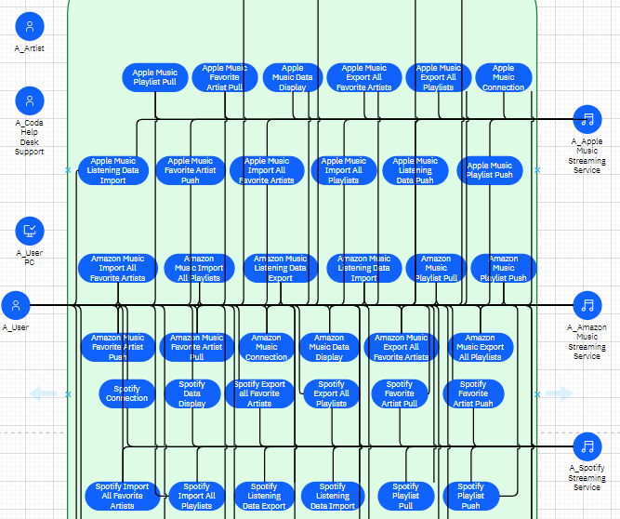
Re-Centering Use Cases
Too many service-specific Use Cases
Cluttered Use Case Diagram
Combined Use Cases around archetypes
End User
Connection to a Service
Playlist Transfer
Favorite Artist Transfer
Artist User
Event Posting
Discography Update

Slide 7
Initial Prototype
Front-end will be developed in Figma
Want to show functionality with different users with some dummy feedback
Has low customization, but will show the general workflow of web app
Have a rough idea of what UI we want
Current work
Need to work on grouping frames and elements into components and get some interactivity by prototyping the frames

Slide 8
Future tasks
Complete front-end prototype
Flesh out the IT System View more
Make new general use-case diagrams for different users
Primarily concerned about the A_User and A_Artist actors
Move onto Component and Operational Models

Slide 9
Links
Trello Board
IBM ITAA Project
If the above fails, try this link
Discord
Figma

